Slide 1

Car Parking Management System
Project Guide:
Karuna Prasad
Presented By (Group No.07)
250850120127 - Priyanshu Patidar
250850120020 - Akshay Uparikar
250850120032 - Anshul Lodhi
250850120035 - Anurag Tiwari
250850120097 - Manohar Dudhat
PG-DAC CDAC BENGALURU

Slide 2

Introduction
Urban parking has become a critical challenge as vehicle ownership continues to rise.
Traditional parking systems create frustration, waste time, and contribute to traffic congestion.
Our web application addresses these pain points by digitizing the entire parking management process, from booking to payment.

Slide 3
Project Objective
Smart Parking Slot Booking: Reserve parking spots in advance via a simple web interface.
Secure Authentication: Role-based login for drivers and admins with strong security.
Record Keeping: Digital logs of vehicles, bookings, and transactions.
Admin Control: Tools to manage slots, users, and system settings.
Real-Time Updates: Live availability display for optimized usage.

Slide 4
Problem Statement
Manual parking systems cause inefficiency, errors, and delays.
No real-time updates → congestion and dissatisfaction.
Paper-based ticketing is outdated and error-prone.
Need for a secure, automated, and scalable solution.

Slide 5
Solution
Centralized digital platform for users and parking staff.
Security Staff dashboard for slot management.
Features: Pre-Book/On spot slot booking, online/offline payments, smooth entry/exit from system.
Records: Digital logs of vehicles, bookings, and transactions at one platform.

Slide 6
Key Feature Of Project
User Authentication System: Secure login and registration with JWT tokens, password encryption, and role-based access control.
Vehicle Registration Module: Complete vehicle information including Vehicle Number, Vehicle Type and owner details for validation.
Admin Dashboard: Comprehensive management interface for manage & assign security staff, managing users.
Intelligent Slot Allocation: Automated parking space assignment based on availability, vehicle type, and user preferences.

Slide 7
Login /
Register
To Park
Search Nearest Parking
Book Slot
Book Confirmed
At Exit Time
Payment
Ticket Generation
Entry To Parking
Cash/QR Payment
Payment Success
Exit
User Flow

Slide 8
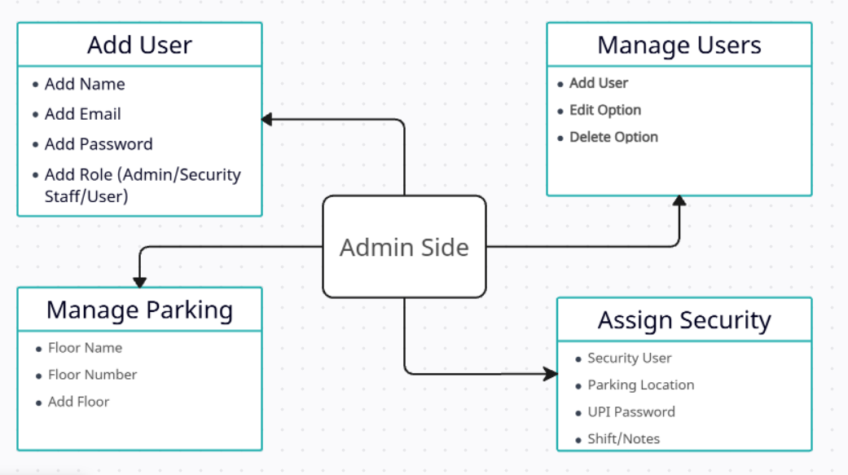
Admin Side

Slide 9
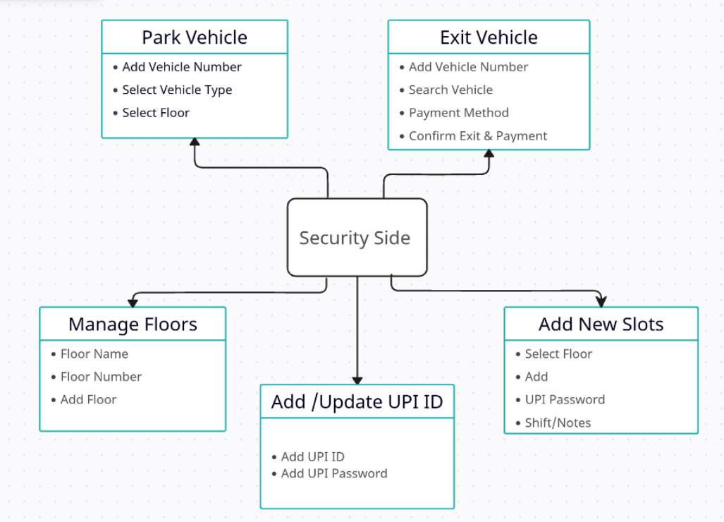
Security Staff Side

Slide 10
Frontend
React.js + Redux
Backend
Node.js + Express.js
Database
MongoDB
Authentication
JWT+ BCrypt
Software Interfaces

Slide 11
Frontend Dependencies | Backend Dependencies
react : UI library | express: Web framework
react-dom : DOM rendering | mongoose : MongoDB ODM
react-router-dom : Routing | jsonwebtoken : JWT authentication
@reduxjs/toolkit : State management | bcryptjs : Password hashing
axios : HTTP client | cors : Cross-origin resource sharing
socket.io-client : Real-time communication | dotenv : Environment variables
leaflet : Maps library | socket.io : Real-time communication
react-leaflet : React maps integration
react-icons : Icon library
qrcode.react : QR code generation

Slide 12
Future Scope
This parking system can be enhanced by adding sensors to display real-time slot availability.
QR codes can be integrated with automatic gates for faster and contactless entry and exit.
A mobile app can be developed for booking, payments, and QR scanning.
These features will make the system suitable for large areas like malls, airports, offices, and smart cities.

Slide 13
Conclusion
The Car Parking Management System is a web-based solution that allows users to register, book parking slots in advance, and make secure online payments. A QR code-based entry and exit system ensures faster and safer parking operations. Overall, this project reduces manual work, improves efficiency, and provides a simple digital solution for parking management.

Slide 14
Thank You…

